Slide 1
lab3_SOC實踐中斷

Slide 2
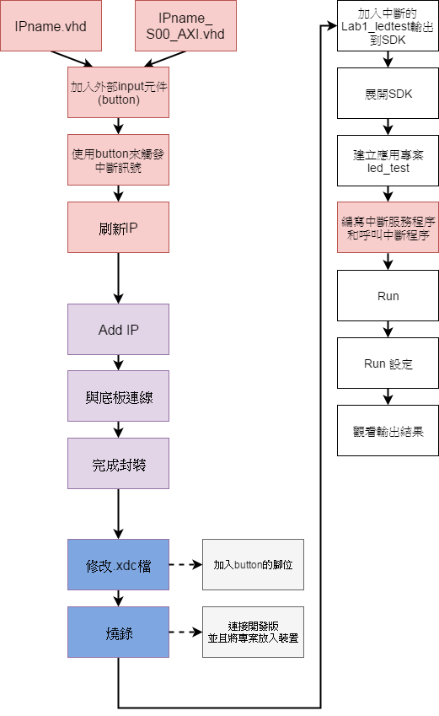

Slide 3
IPname.vhd

Slide 4
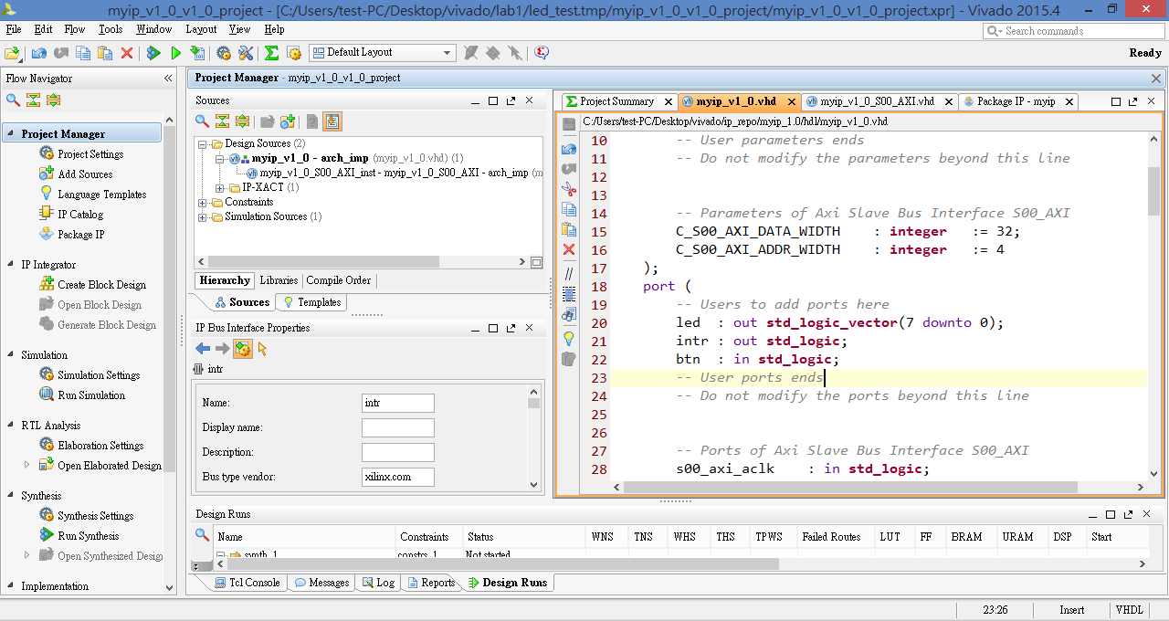

Slide 5
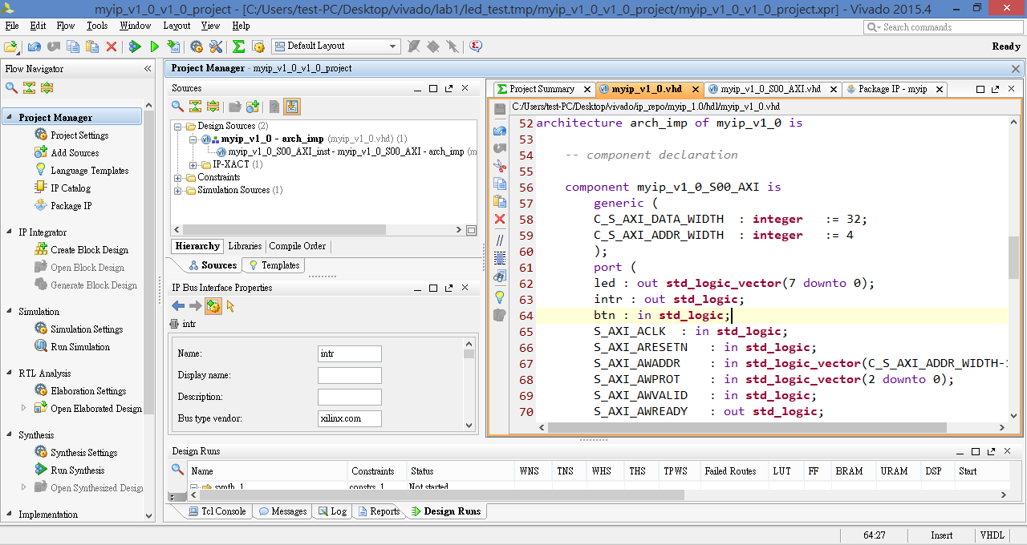

Slide 6
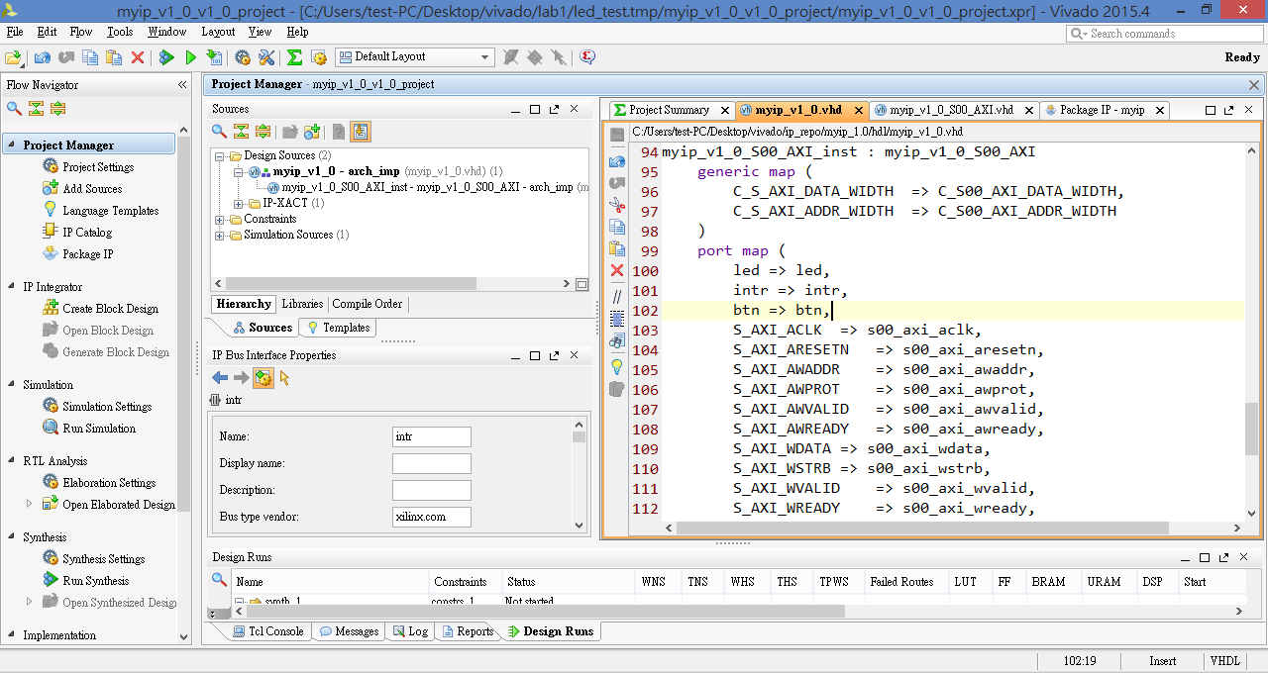

Slide 7
IPname_S00_AXI.vhd

Slide 8
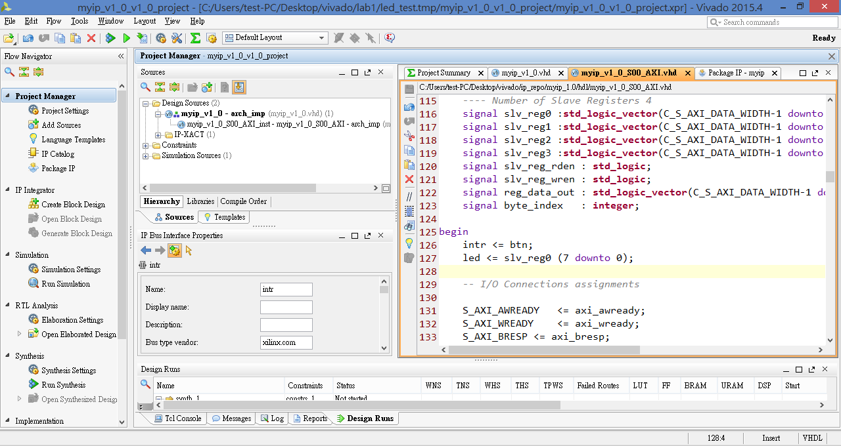

Slide 9
設定IP之中斷訊號輸出腳位

Slide 10
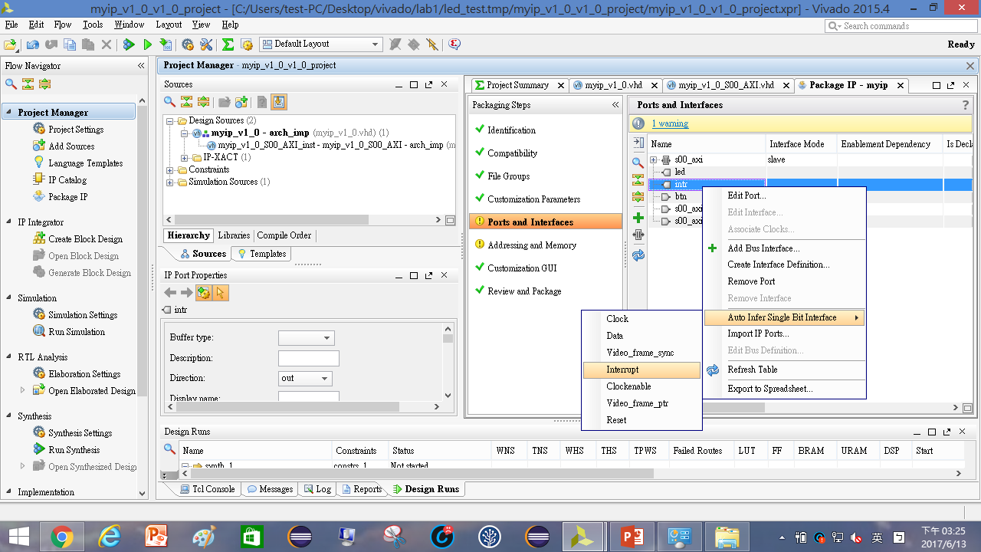

Slide 11
刷新IP

Slide 12
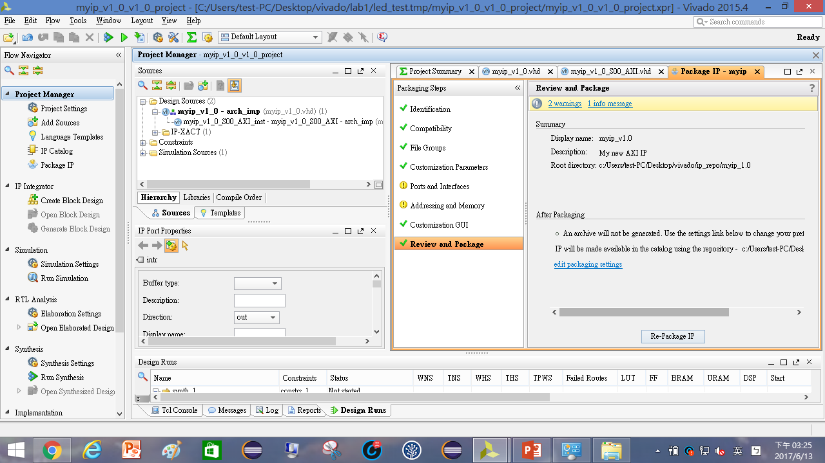

Slide 13
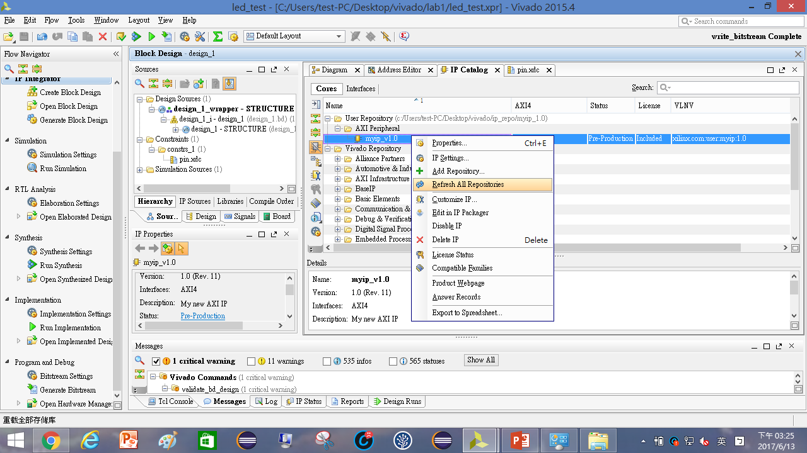

Slide 14
重新佈線

Slide 15
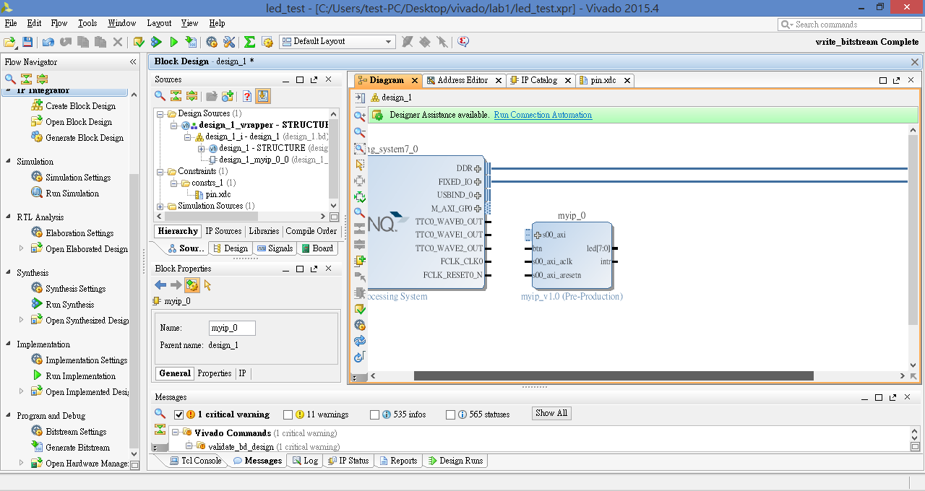
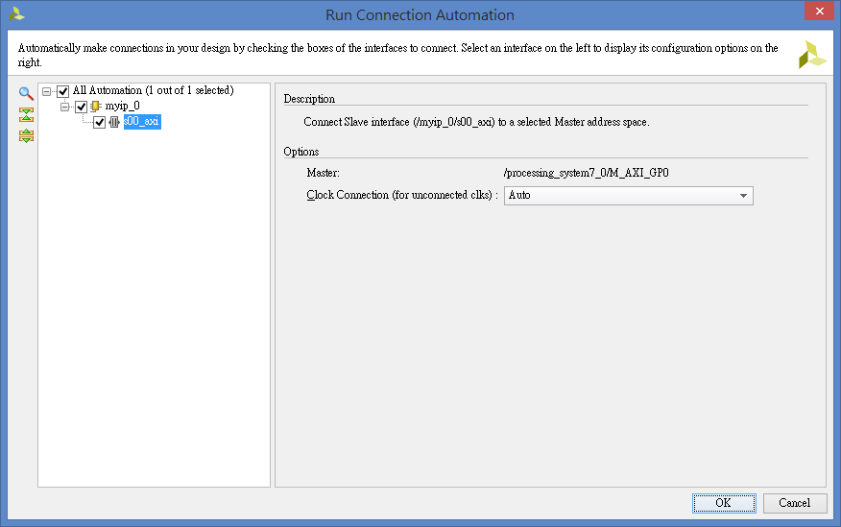

Slide 16
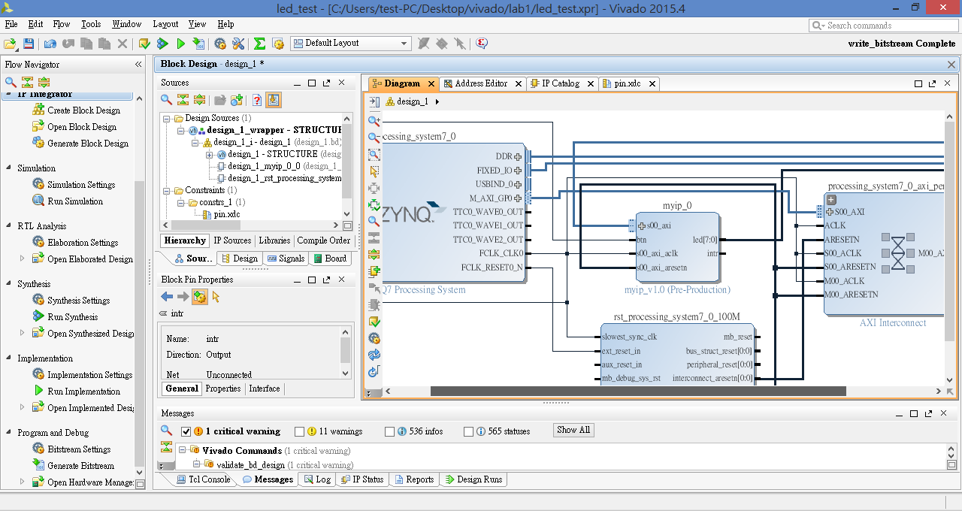

Slide 17
定義底板中斷輸入腳位

Slide 18
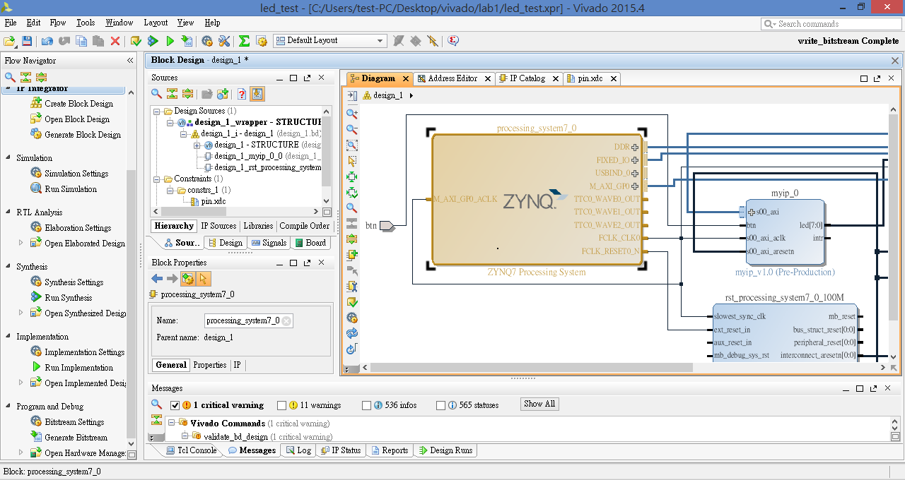

Slide 19
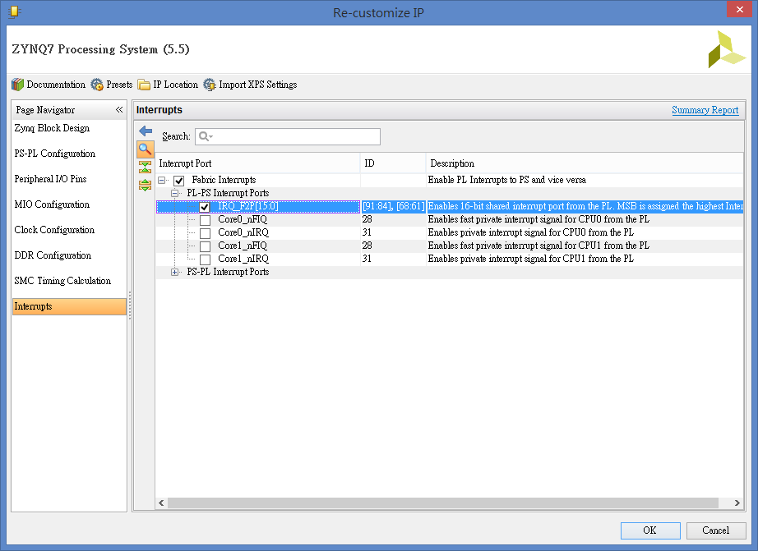

Slide 20
完成封裝

Slide 21
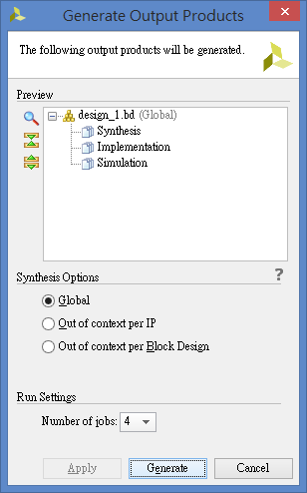
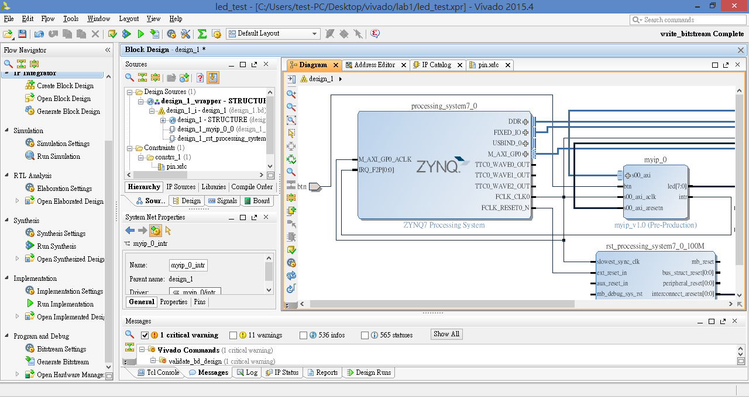
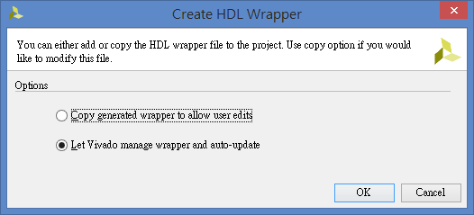
右鍵

Slide 22
修改.xdc檔

Slide 23
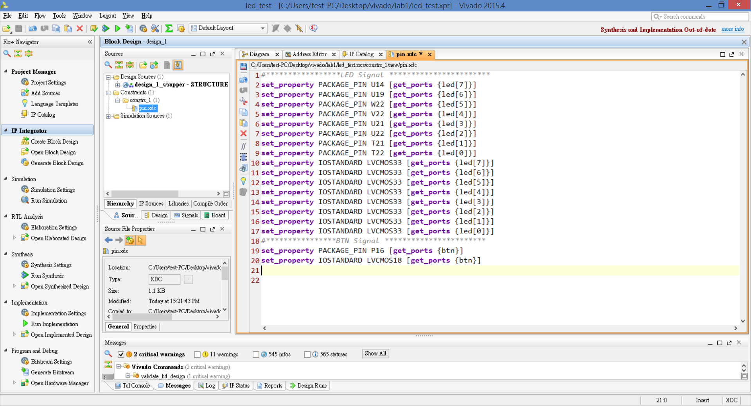

Slide 24
加入中斷的Lab1_ledtest輸出到SDK

Slide 25
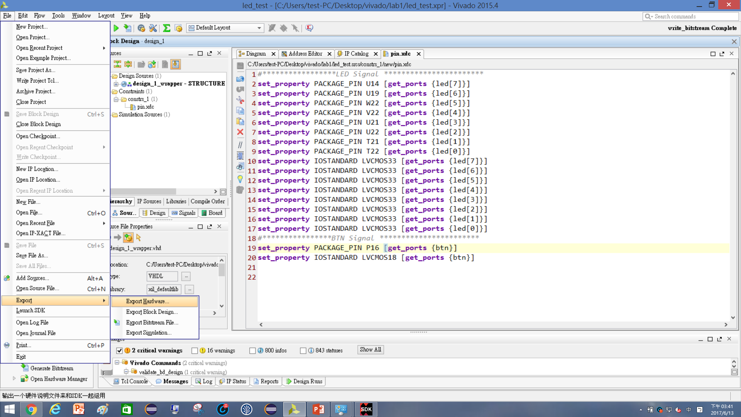


Slide 26
展開SDK

Slide 27
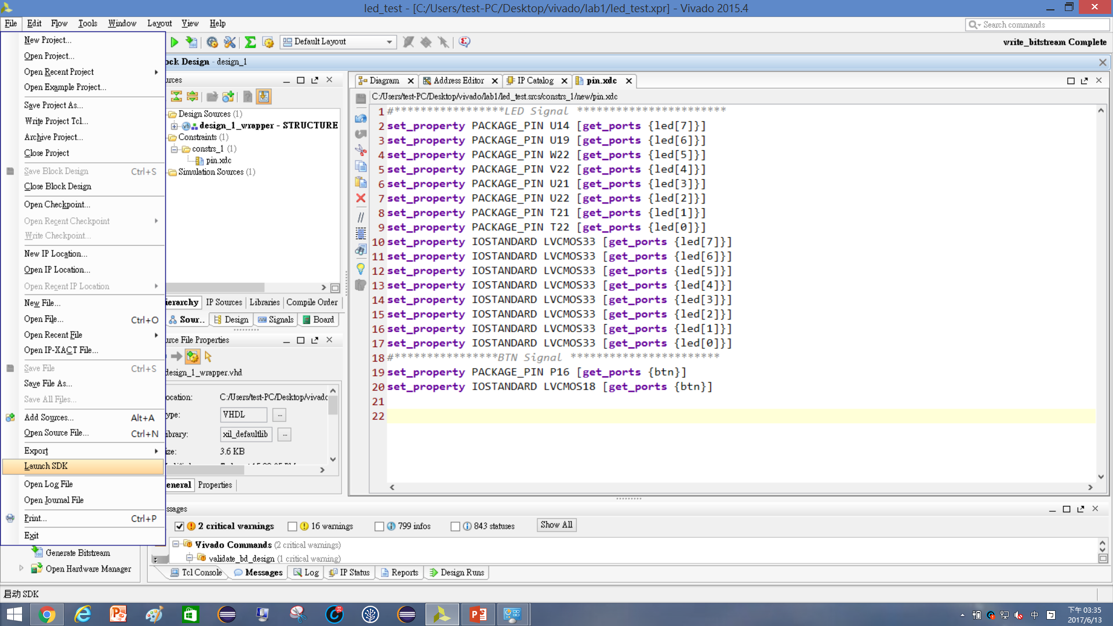


Slide 28
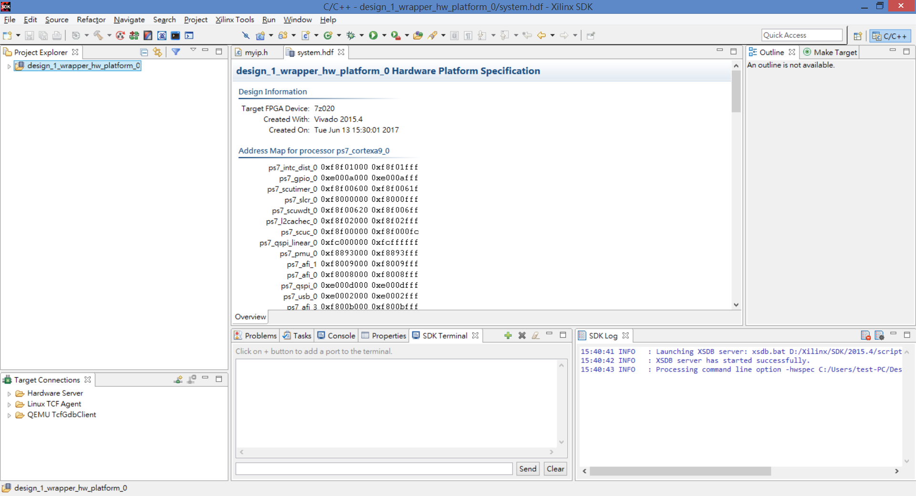

Slide 29
建立應用專案led_intr

Slide 30
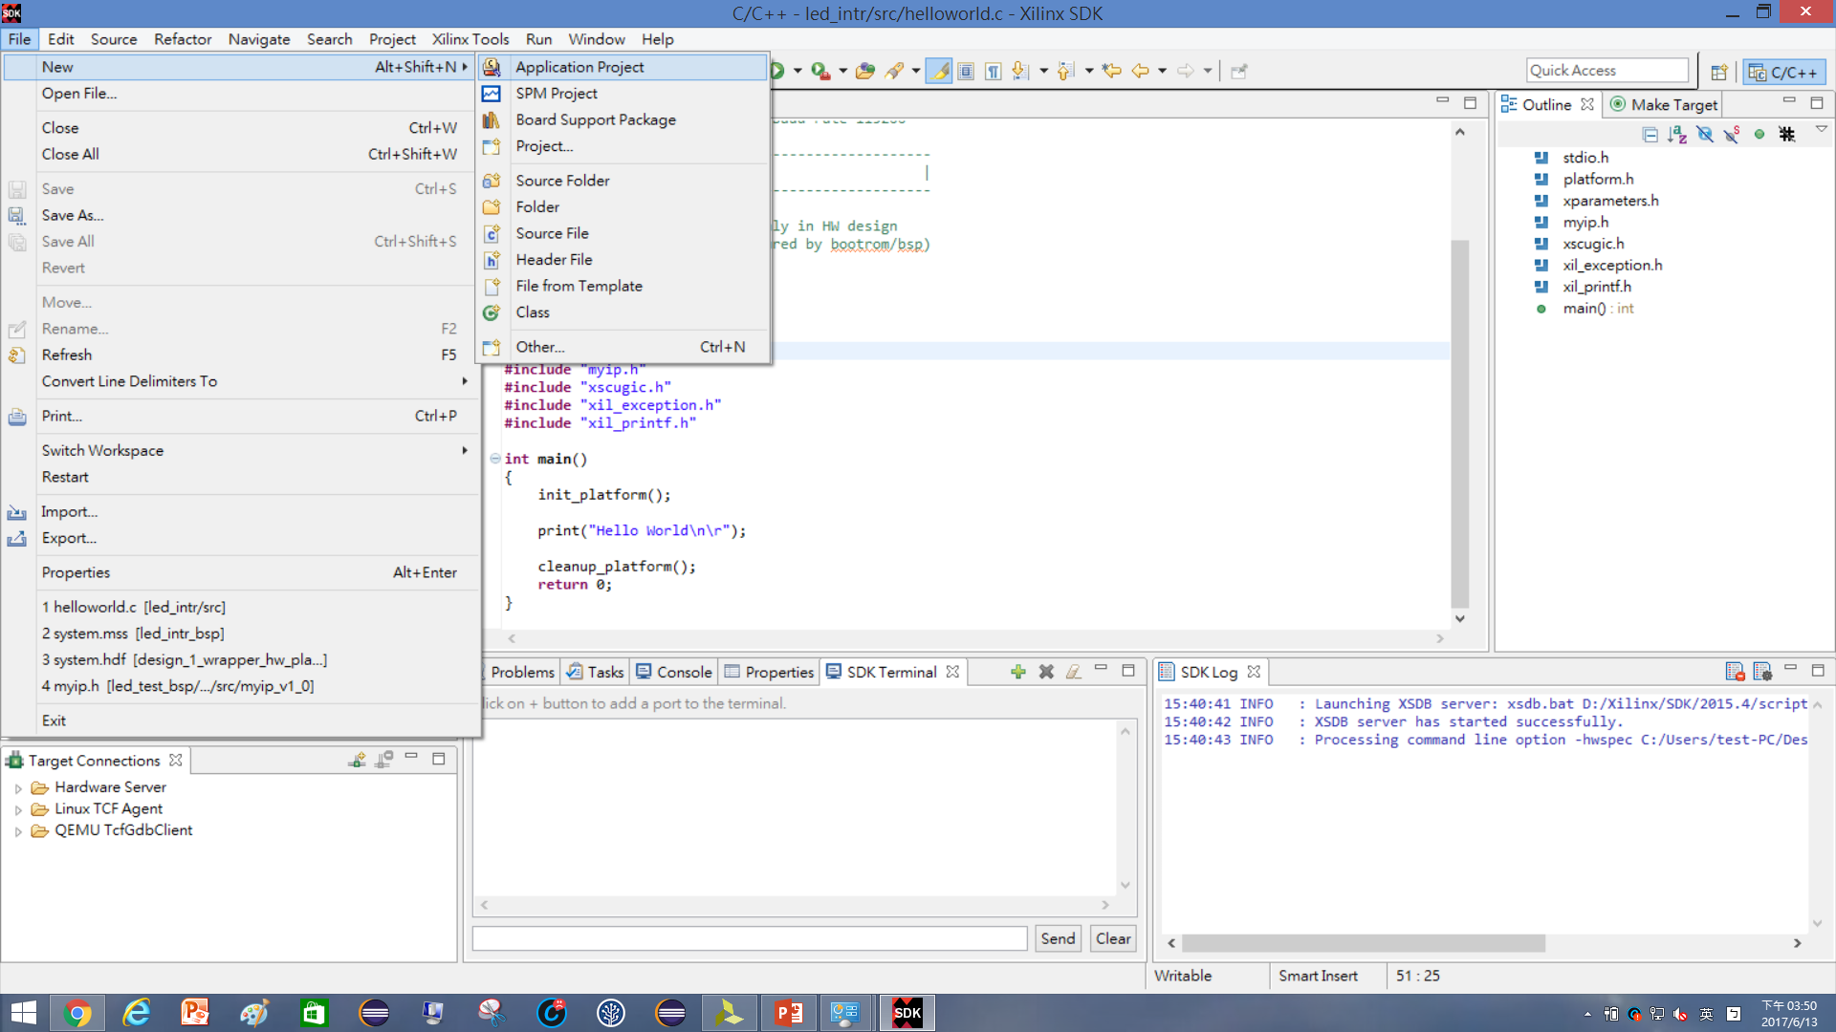
2

Slide 31
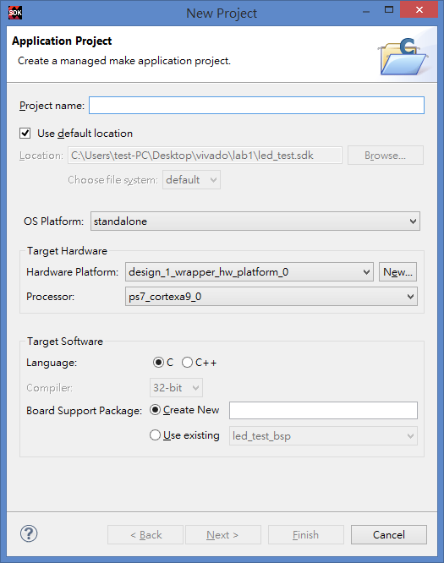

Slide 32
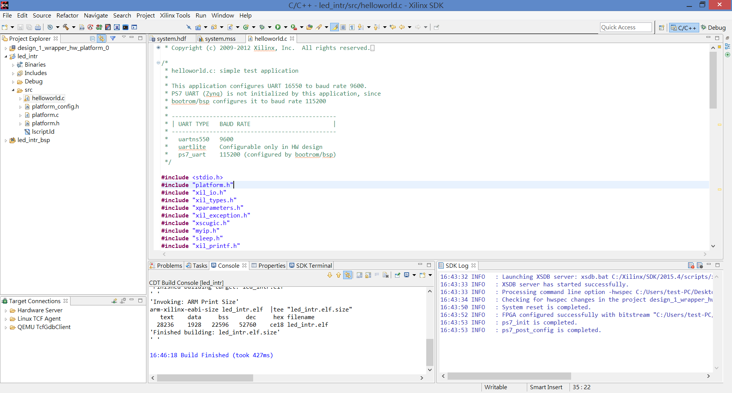

Slide 33
編寫中斷服務程式—原始碼

Slide 34
1.函式庫
#include <stdio.h>
#include "platform.h"
#include "xil_io.h"
#include "xil_types.h"
#include "xparameters.h"
#include "xil_exception.h"
#include "xscugic.h"
#include "myip.h"
#include "sleep.h"
#include "xil_printf.h"
3. interrupt handler
void INTERRUPT_Handler0(void *baseaddr_p){
int i;
xil_printf("Push Button was pressed\r\n");
}
4.中斷初始化
int ScuGicInterrupt_Init(void)
{
int Status;
Xil_ExceptionInit();
GicConfig = XScuGic_LookupConfig(XPAR_PS7_SCUGIC_0_DEVICE_ID);
if (NULL == GicConfig){
return XST_FAILURE;
}
Status = XScuGic_CfgInitialize(&InterruptController,GicConfig,GicConfig->CpuBaseAddress);
if (Status != XST_SUCCESS){
return XST_FAILURE;
}
Xil_ExceptionRegisterHandler(XIL_EXCEPTION_ID_IRQ_INT,(Xil_ExceptionHandler)XScuGic_InterruptHandler,(void *) &InterruptController);
Status = XScuGic_Connect(&InterruptController,XPAR_FABRIC_MYIP_0_INTR_INTR,(Xil_ExceptionHandler)INTERRUPT_Handler0,(void *)&InterruptController);
XScuGic_Enable(&InterruptController, XPAR_FABRIC_MYIP_0_INTR_INTR);
Xil_ExceptionEnable();
XScuGic_SetPriorityTriggerType(&InterruptController, XPAR_FABRIC_MYIP_0_INTR_INTR,0xa0,3);
if (Status != XST_SUCCESS)
return XST_FAILURE;
}
2.變數宣告
XScuGic InterruptController;
static XScuGic_Config *GicConfig;
5.Main
int main()
{
int xstatus;
int i=0;
// interrupt test
xstatus = ScuGicInterrupt_Init();
if (xstatus != XST_SUCCESS)
return XST_FAILURE;
//Wait For interrupt
init_platform();
while(1){
for (i=0;i<=255;i++){
xil_printf("i = %d\n\r",i);
MYIP_mWriteReg(0x43C00000, MYIP_S00_AXI_SLV_REG0_OFFSET, i);
sleep(1);
}
}
//xil_printf("Hello World\n\r");
return 0;
}

Slide 35
編寫中斷服務程式—offset address

Slide 36
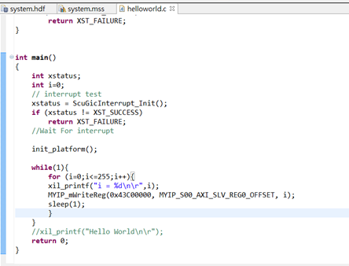
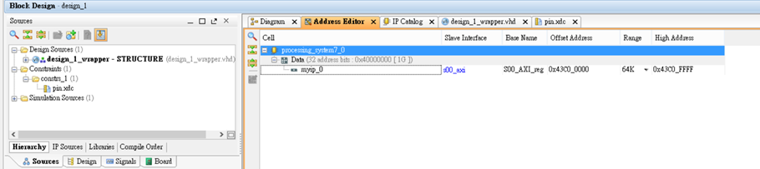
觀看IP的中斷腳位

Slide 37
Run

Slide 38
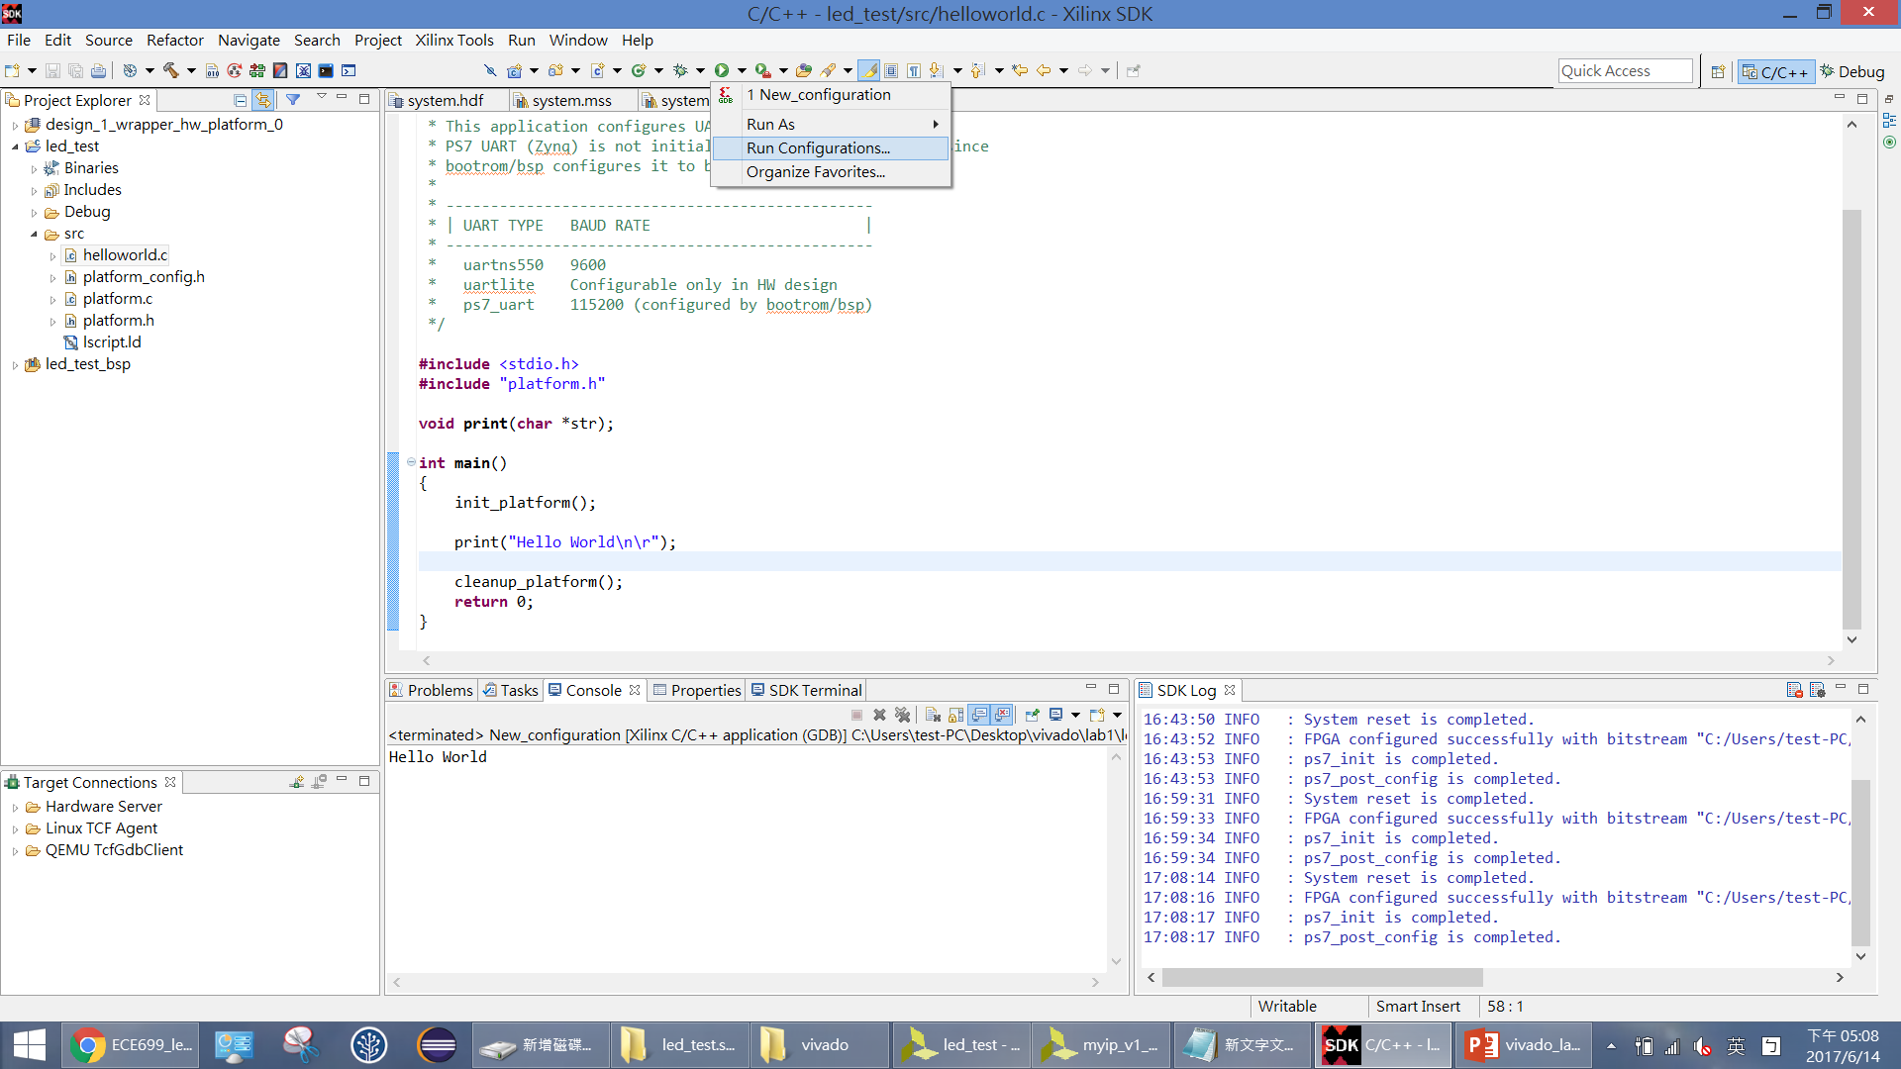

Slide 39
Run設定

Slide 40
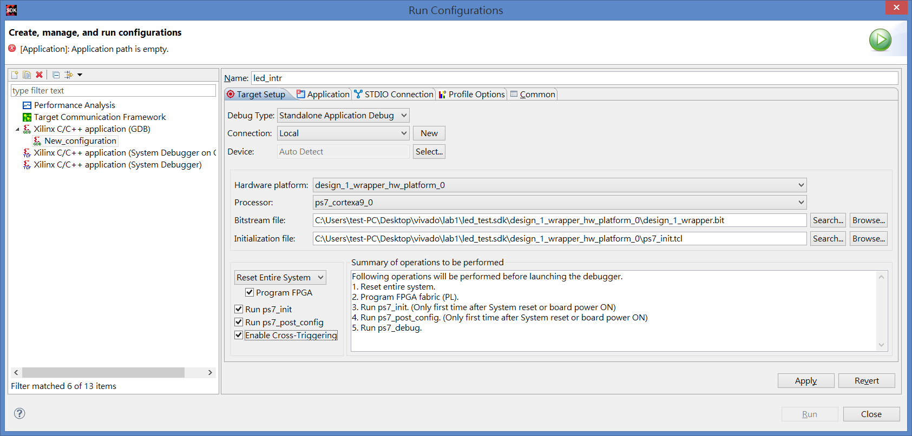

Slide 41
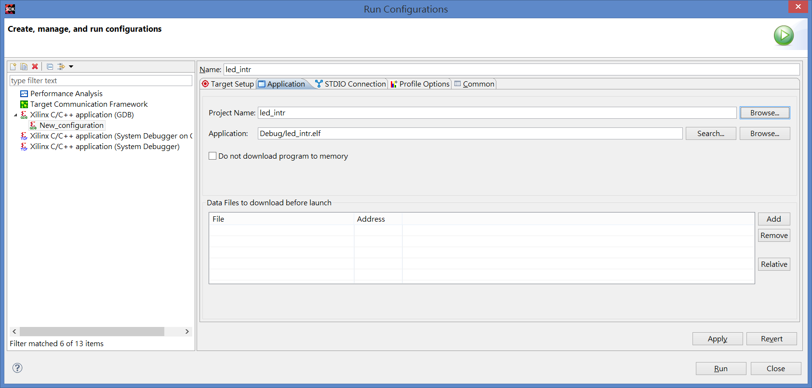

Slide 42
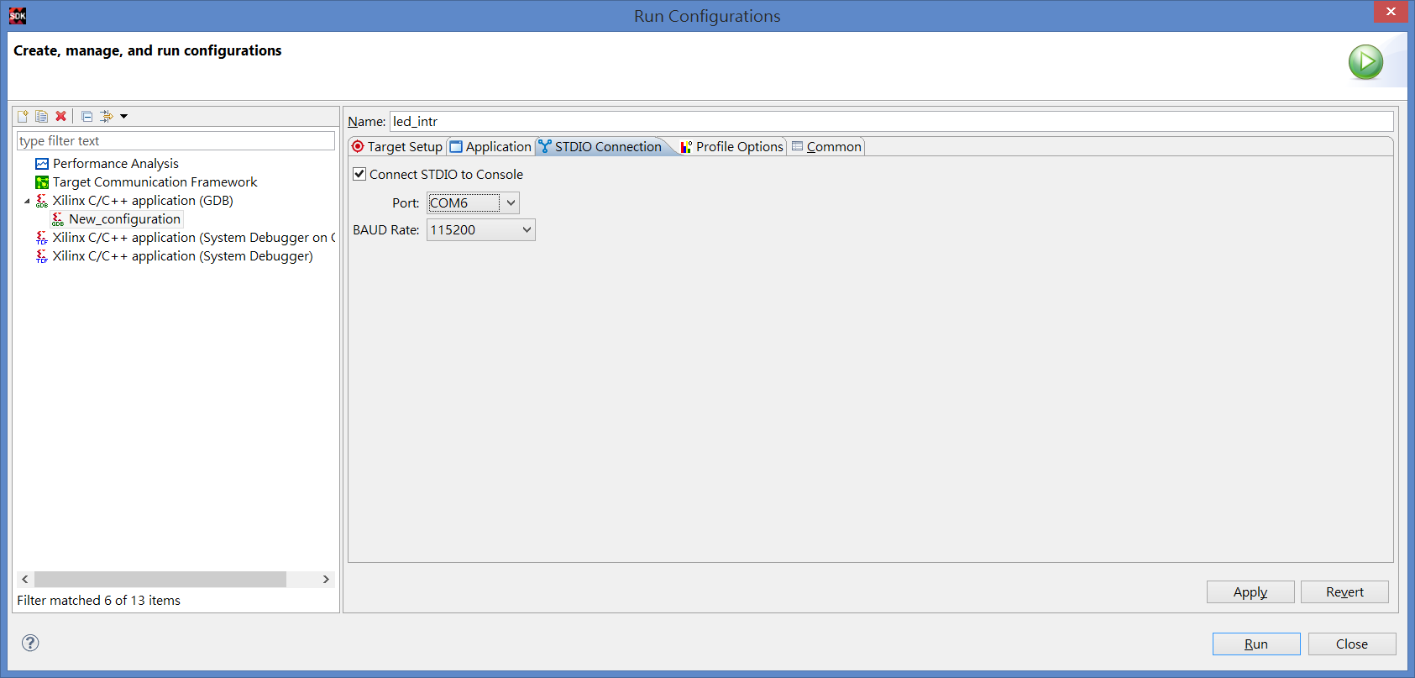

Slide 43
觀看輸出結果

Slide 44
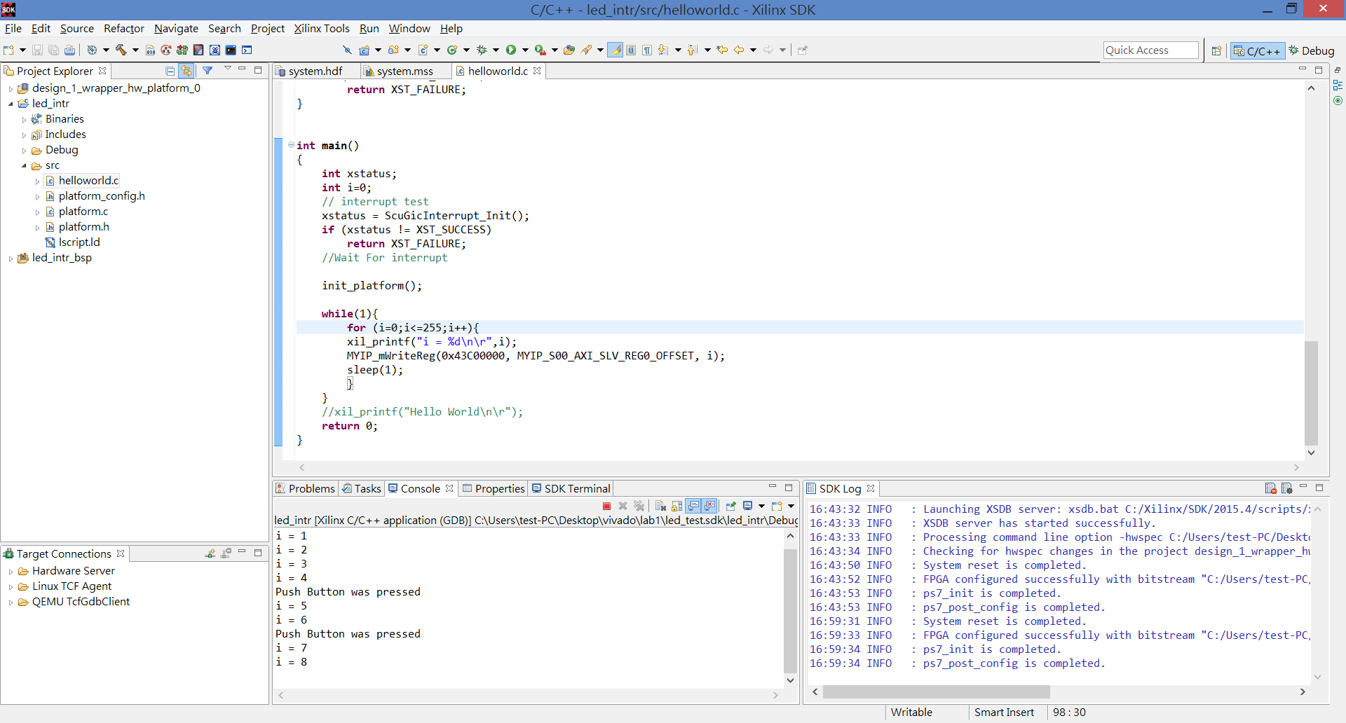
0

